Slide 1

Olympic Track and Field Insight
Group Members
David Wu Donald Yakam
Huss Issa Matt Kenney
Nwagbo Chidozie Peter Drozdzewicz
Ricardo Benitez Rodney Daverman
Shailja Mathur

Slide 2
Project Proposal
For years, Olympics have been held around the world, and participants from around the world compete to succeed in different sports. We wanted to work with this data because we want to look for answers to the questions about which countries are superior in which branches, which countries are leading women or men in which sports and bringing medals to their country.
For our data, we selected Track and Field data from the Olympic games over the last century. Dataset contains 2395 rows. and variables like gender, year, event and location, name, nationality.
The Sources of our Data Set - https://www.kaggle.com/jayrav13/olympic-track-field-results?select=results.csv

Slide 3
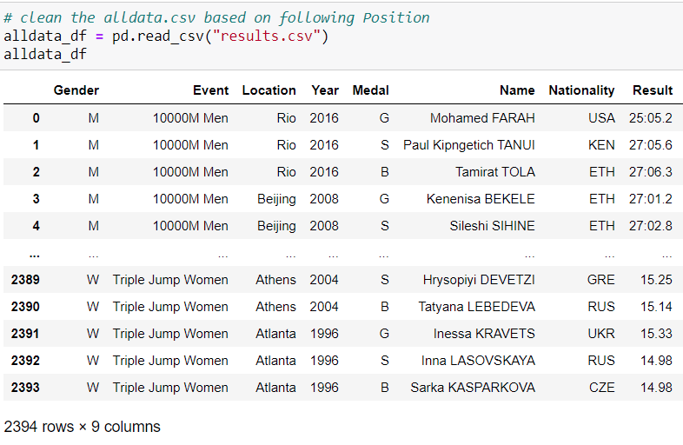

Slide 4
Insights
Count of Medals by Nation.
What year USA won Gold in a 100M Dash – Women.
What year USA won Gold in a 100M Dash – Men.

Slide 5
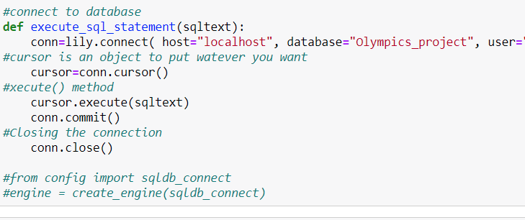
Postgres Server through SqlAlchemy
Imported Data into Postgres, SqlAlchemy, to draw various insights

Slide 6
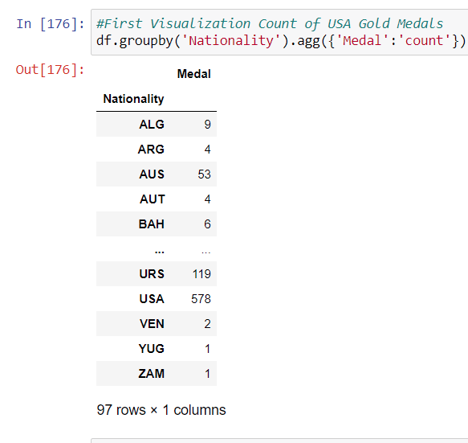
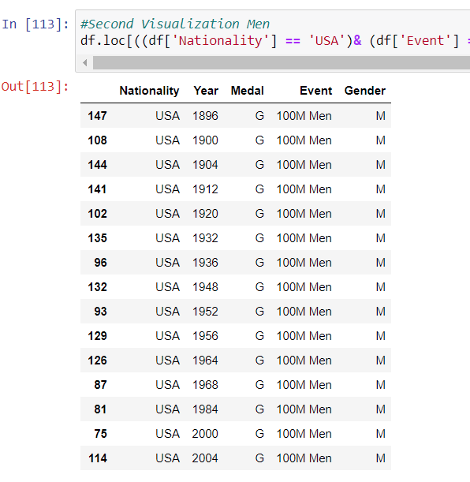
Creating subsets to prepare Visualizations

Slide 7
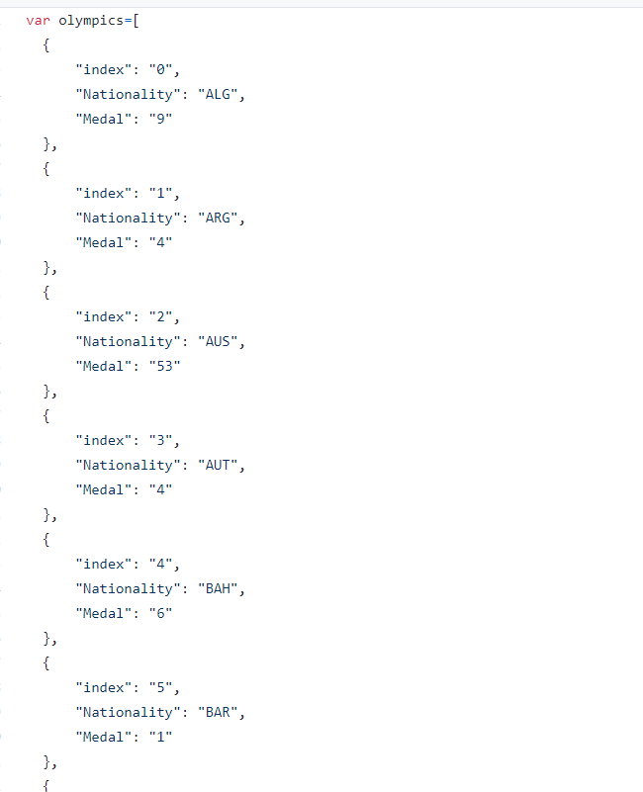
Converting from csv to json
For Plotly visualizations, the postgres data was saved as csv and then converted to Json, to prepare for Plotly.js

Slide 8
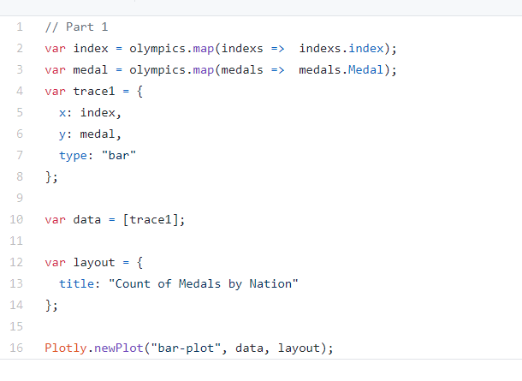
Plotly Visualizations
Plotly script to visualize our data

Slide 9
Challenges
Flask
Unfortunately on our last day Project work class we ran out of time with figuring out the Flask Server
Datatypes
We has an issue visualizing the results column dealing with the datatypes between Sql and Python SqlAlchemy

Slide 10
Questions?

